Slide 1
Data treatment with
Mantid at the ILL
I. Bush, M. Gonzalez, V. Reimund, A. Soininen, G. Vardanyan

Slide 2
Status of the Bastille project
Technique | Instruments | Mantid Version | Progress
Back-scattering | IN16B | 3.9 | Production use, 1 cycle, 2017
TOF spectroscopy | IN4, IN5, IN6 | 3.11 | Ready, validated by scientists
Reflectometry | D17, FIGARO | 3.12 | Development/testing ongoing
Powder Diffraction | D20, D2B, D1B | 3.12 | Development/testing ongoing
SANS | D11, D22, D33 | - | Instrument definitions, early tests with EQSANS
Autoreduction | FIGARO (first test) | - | First prototype in place
After a long shutdown, the reactor will restart in March 2018.

Slide 3
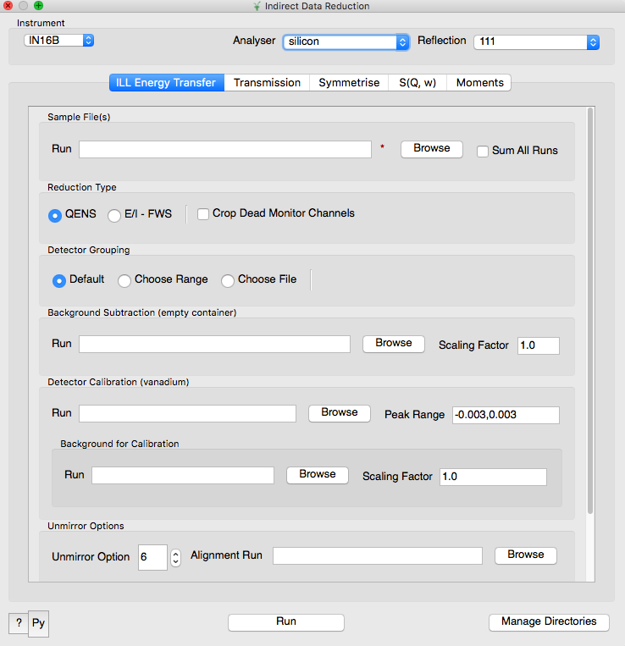
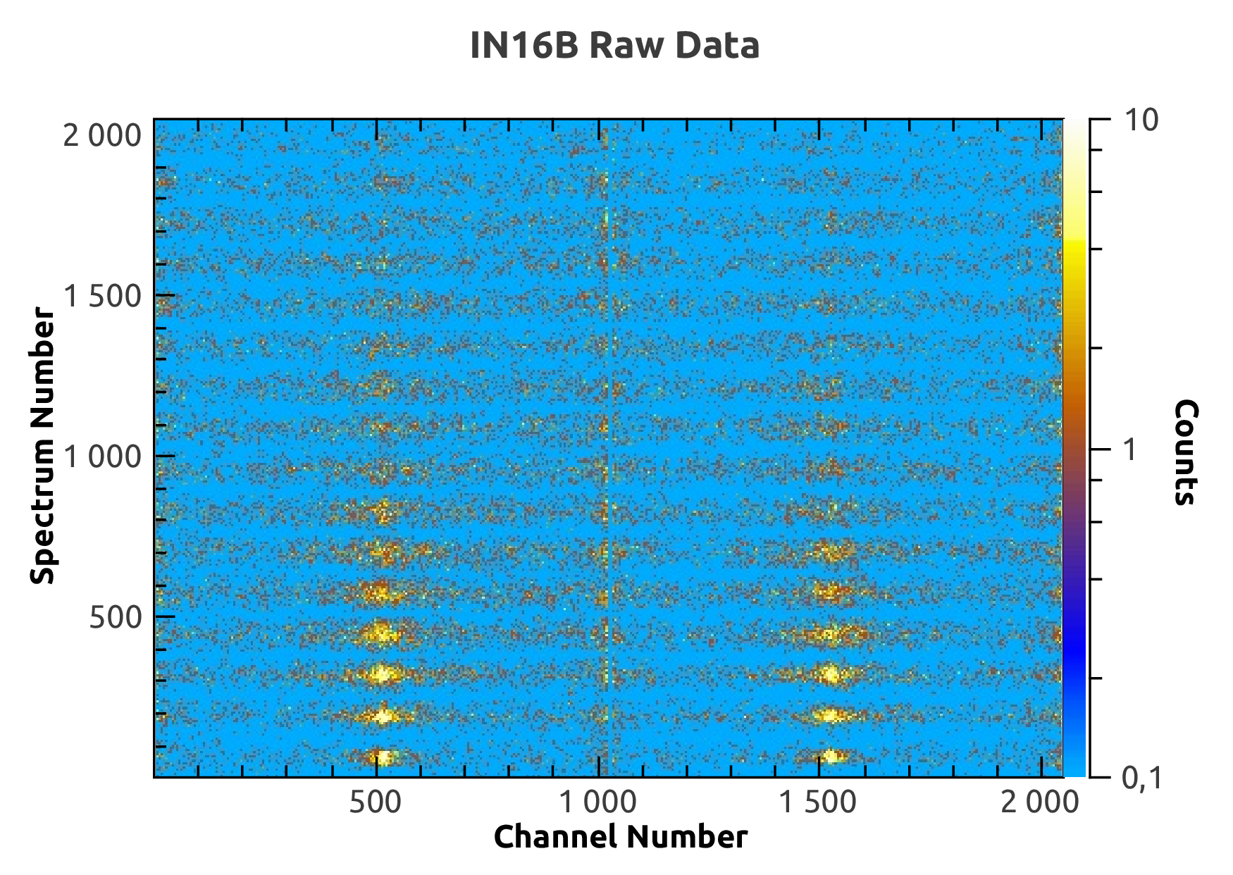
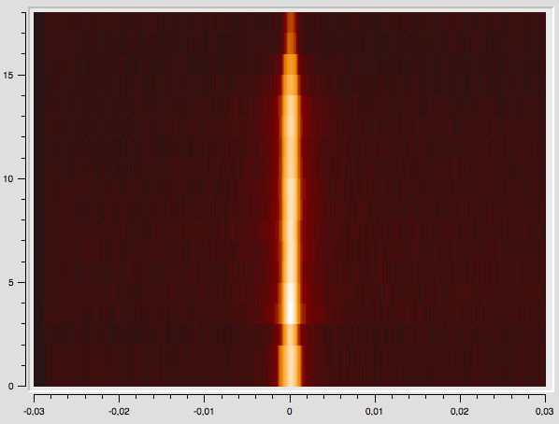
Back-scattering, IN16B
Reduction algorithms and a custom GUI are available since v3.9
Used in 1st cycle 2017 + being used for older data (back to 2013)
Implements QENS, E/I FWS reductions
More work foreseen in future
QENS, FWS fitting (analysis)
Complete attenuation corrections (cross-terms in MC absorption)
New TOF mode (BATS)

Slide 4
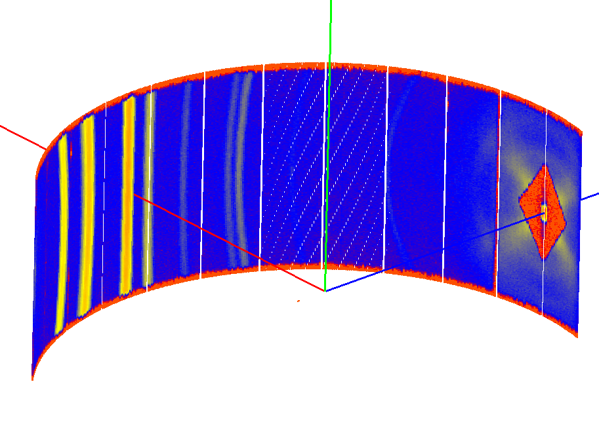
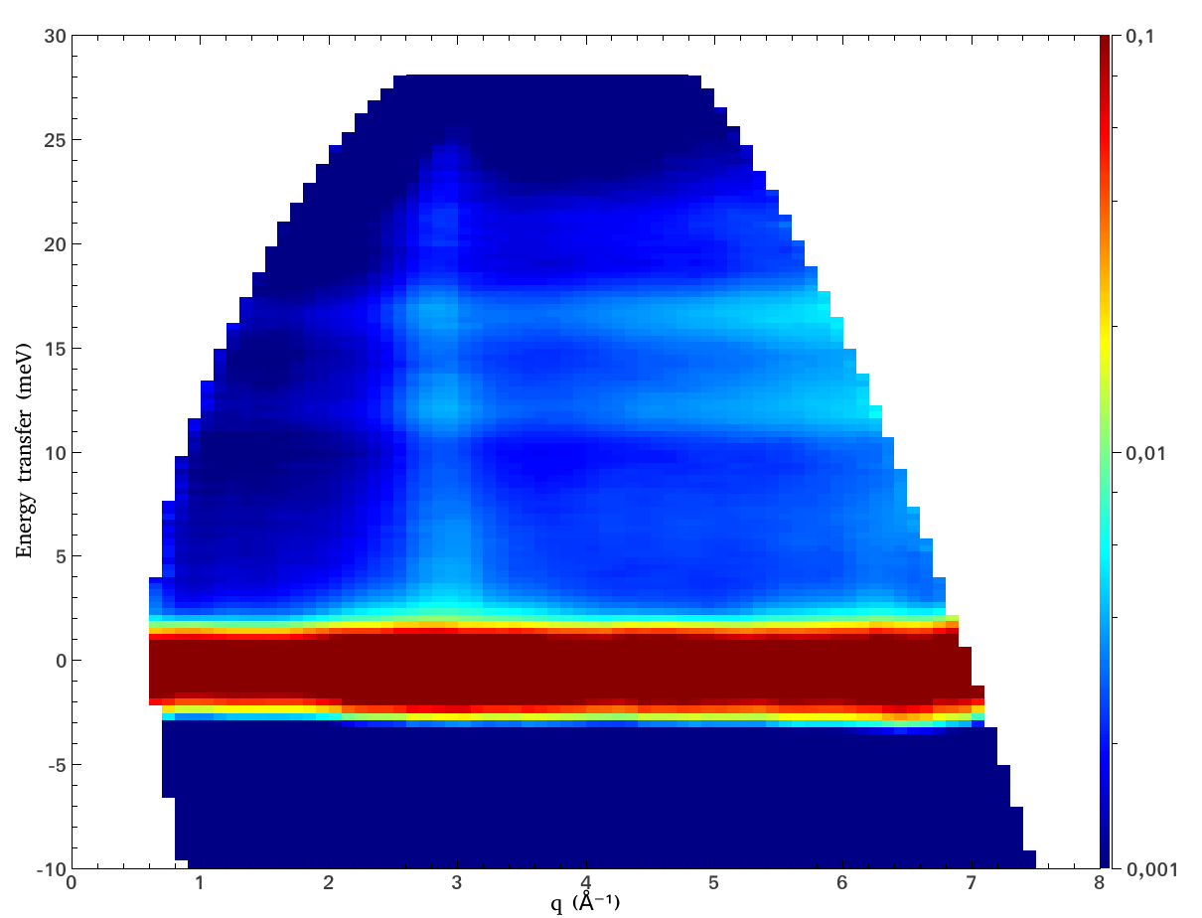
TOF Spectroscopy
Reduction algorithms available since v3.11
IN5, raw data
IN4, reduced data
Instruments covered: IN4, IN5, IN6
Results validated against LAMP
Live demo tomorrow

Slide 5
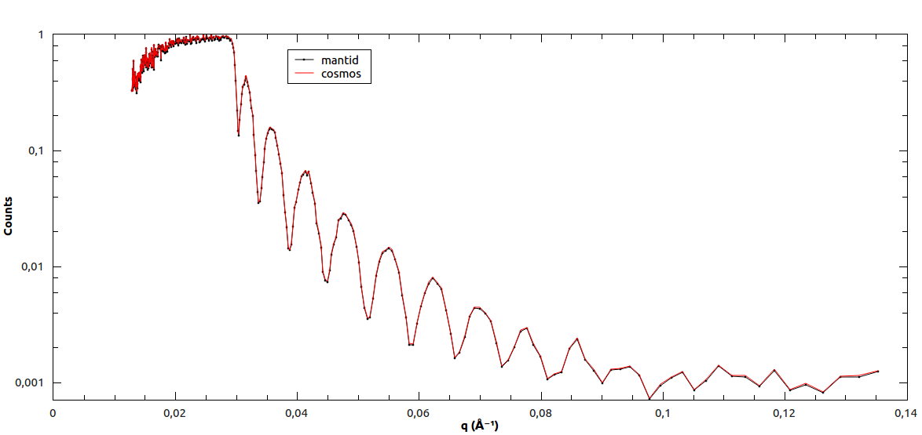
Reflectometry
Work in progress
1D data in TOF mode – close to final
Polarization corrections (for D17)
Gravity corrections (for Figaro)
Coherent mode to be implemented
Monochromatic mode (scan) to follow
Benchmarked against existing COSMOS package for reflectometry reduction.

Slide 6
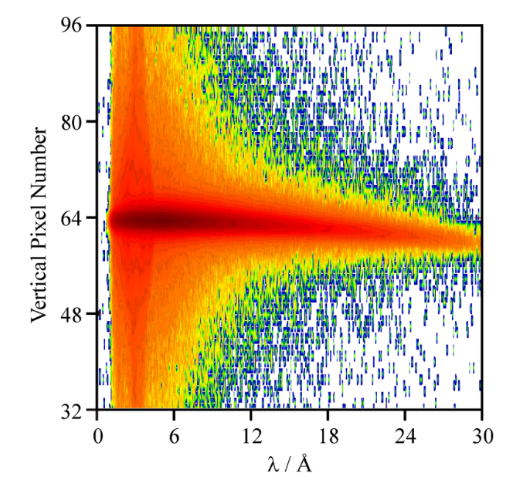
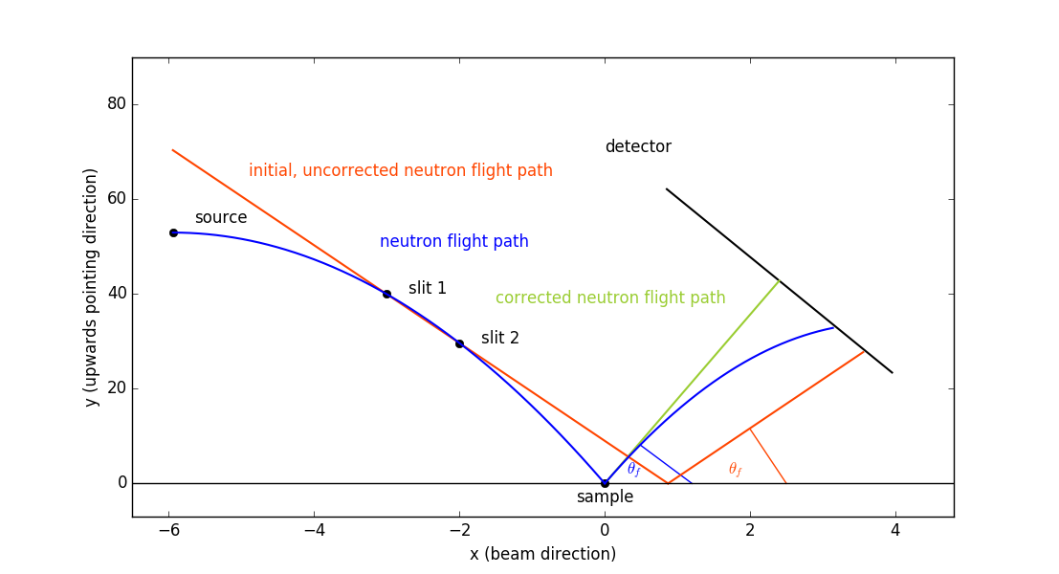
Gravity Correction
Correction adjusts both the reflection angle (pixel hit) and the TOF channel, to cancel out the gravity drop
arXiv:1710.04139v2
Eur. Phys. J. Plus (2011) 126: 107
Measurable effect on cold neutrons

Slide 7
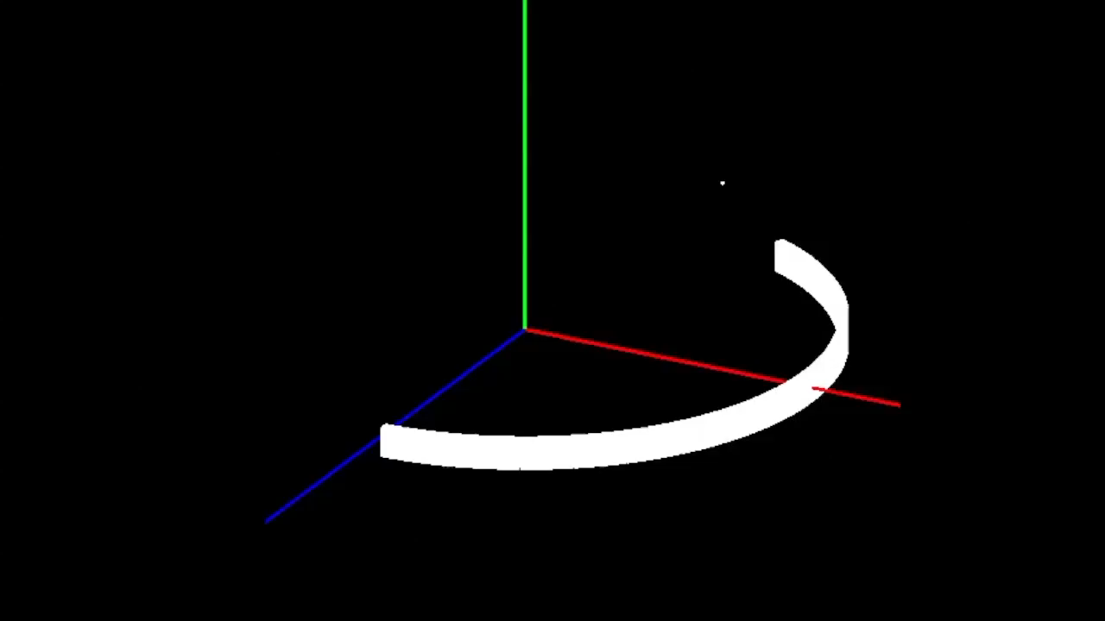
Powder Diffraction
Detector scan, D20
Work to support detector scans in collaboration with ESS (Simon Heybrock and Owen Arnold)
Time-indexed instrument handling in the framework
D2B and D20 run synchronous step scans by rotating the whole detector around the sample in the scattering plane
Number of algorithms extended to support time-indexed workspaces, including:
MergeRuns
NormaliseToMonitor
GroupDetectors
… some more to come
Support for other scanning instruments at the ILL in the future

Slide 8
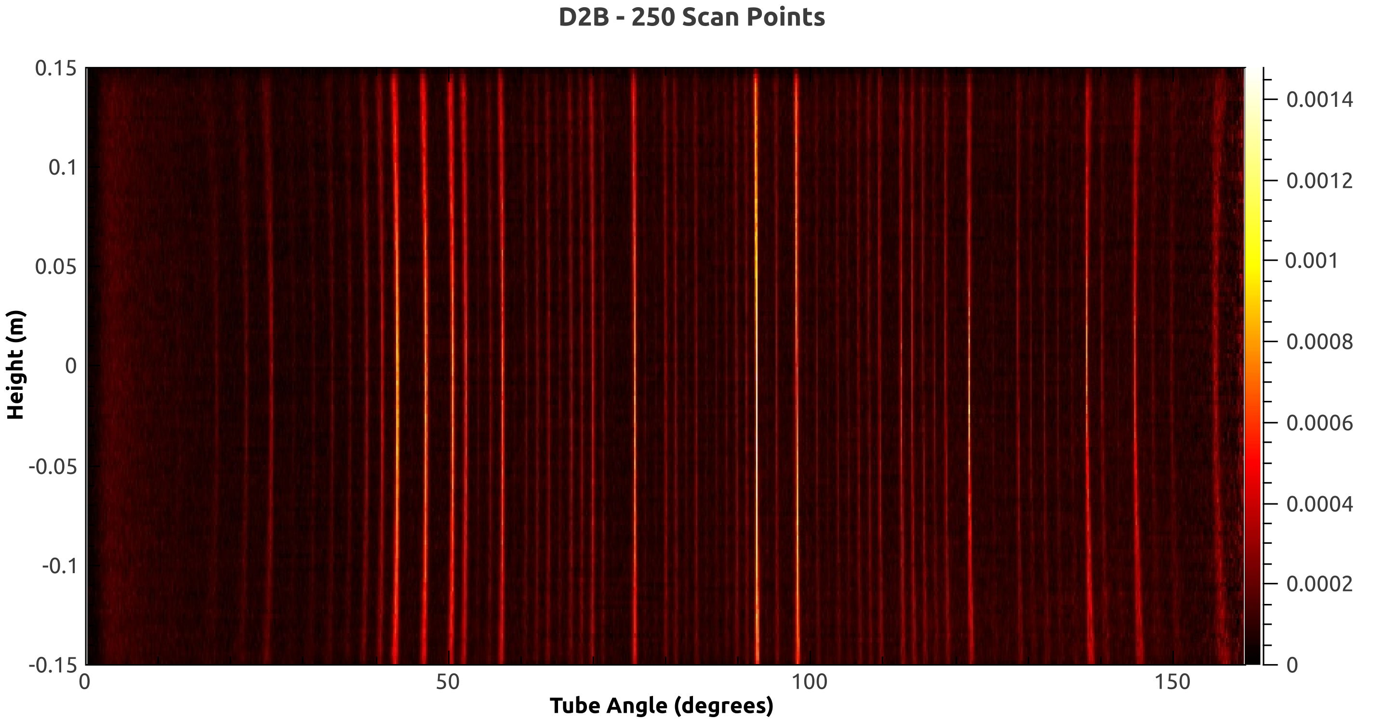
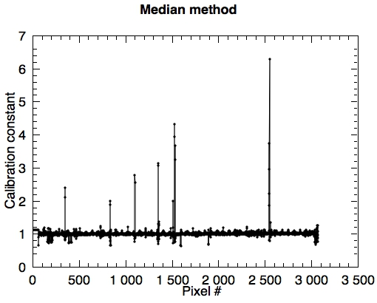
Detector Scan
Detector efficiency estimation using the detector scan, D20
Data reduction with scanned configuration, D2B

Slide 9

Infrastructure Update
Instrument workstations being setup
New machines dedicated to running data reduction with Mantid
Ubuntu 16.04 LTS
Mantid 3.11 pre-installed
Nightlies will be used for techniques in progress
Build servers arrived, waiting for setup
Mac, OS X 10.13
Ubuntu 16.04 LTS
Windows 10

Slide 10



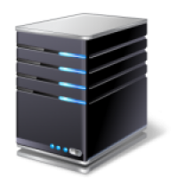


Pseudo-live
Reduction
AMEO
Client Terminal
Instrument Control Workstation
Reduction Server
Nomad GUI
Nomad Server
Raw data (.nxs)
Mantid python reduction script
Reduced data (.nxs)

Slide 11
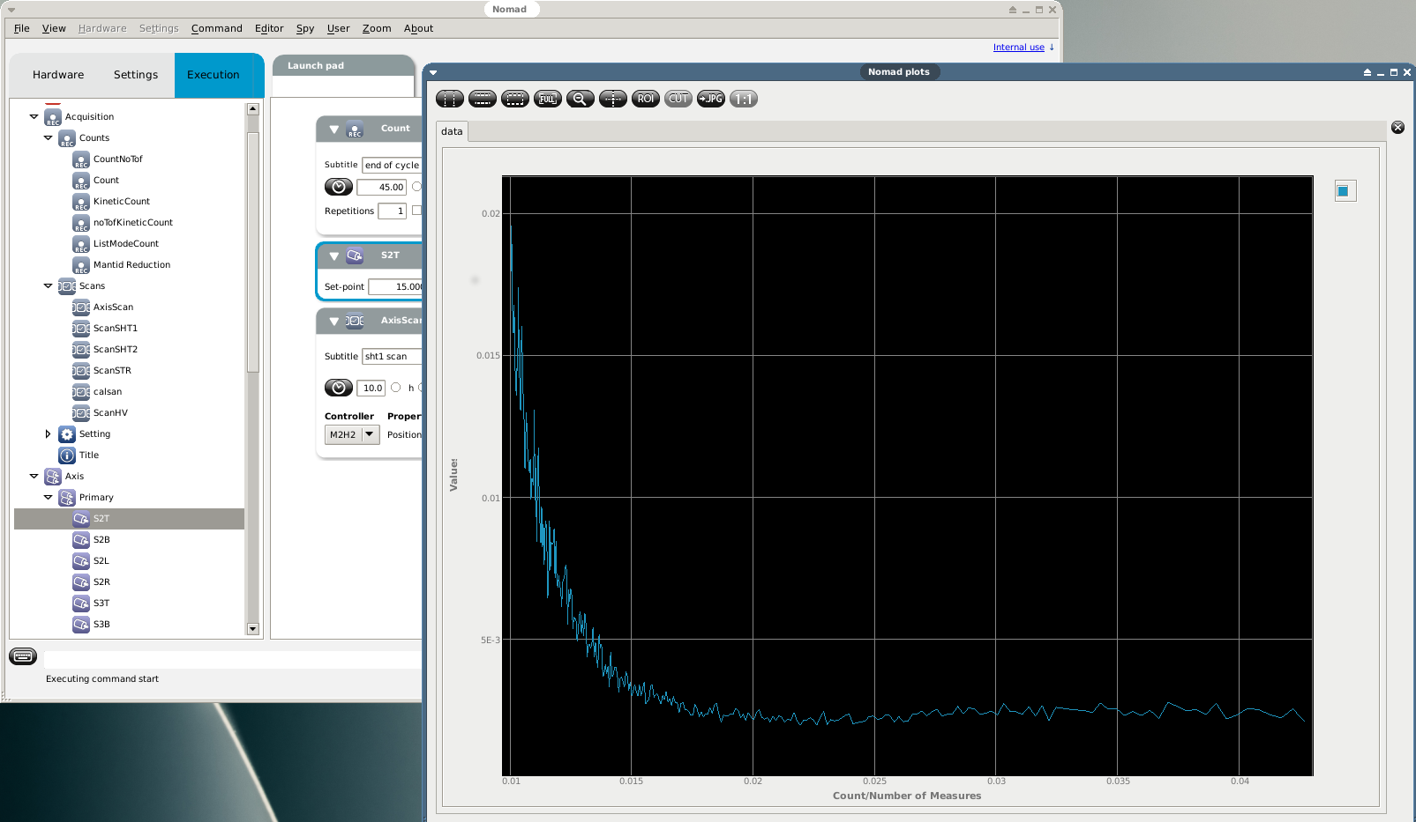
Reduced Data in Nomad
Processed by
Add possibility to make decisions based on
the reduced data (e.g. stop/continue)

Slide 12
Plans for Future
Finalize Reflectometry and Powder Diffraction reductions
On-going support for TOF spectroscopy and Back-scattering
Develop SANS treatment into a complete usable reduction
GUIs for Reflectometry and SANS
User training (first session next week)
Work with Instrument Control group towards autoreduction (for all instruments that will run Mantid)

Slide 14

Pseudo-live
Reduction
AMEO
Service Manager and Inter-process Communicator based on ZeroMQ.
Implemented in Java with client APIs in Java and C++.
Client Terminal
Instrument Control Workstation
Reduction Server
Nomad Client GUI [Java]
Nomad Server Application [C++]
Reduction Server Application [C++]
Raw data (.nxs)
Cameo Reduction Requester
Reduced data (.nxs)
Cameo Reduction Responder
Mantid python reduction script
Virtual Filesystem
https://code.ill.fr/cameo/cameo-commons/wikis/home

